Slide 1


Engineering Analytics & Machine Learning
(ECSE202)
Seminar 8
Introduction to Deep Learning
AY2018/2019 OCT SEMESTER

Slide 2
Brief history How we get here?

Slide 3
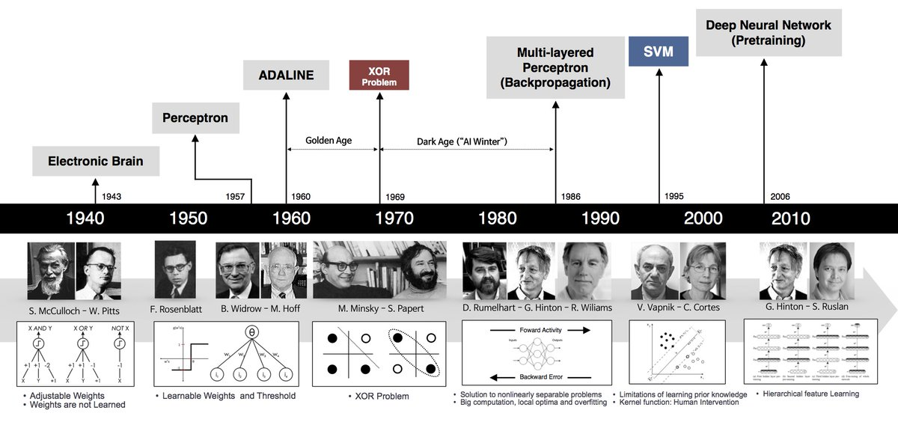
Machine Learning: Trend
Souorce:https://twitter.com/deeplearn007/status/945381750494191616

Slide 4
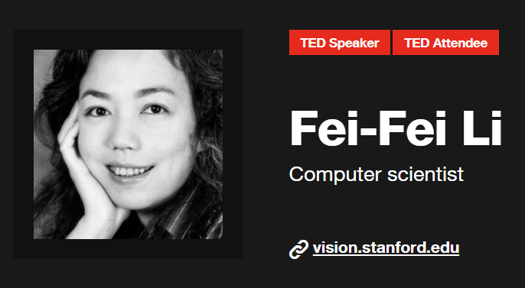
Machine LeaHow we teach TED Talk by Fei Fei Li Deep Learning: ImageNet
Why you should listen
Using algorithms built on machine learning methods such as neural network models, the Stanford Artificial Intelligence Lab led by Fei-Fei Li has created software capable of recognizing scenes in still photographs -- and accurately describe them using natural language. Li’s work with neural networks and computer vision (with Stanford’s Vision Lab) marks a significant step forward for AI research, and could lead to applications ranging from more intuitive image searches to robots able to make autonomous decisions in unfamiliar situations.
https://www.youtube.com/watch?v=40riCqvRoMs
Notes:
https://www.youtube.com/watch?v=40riCqvRoMs

Slide 5
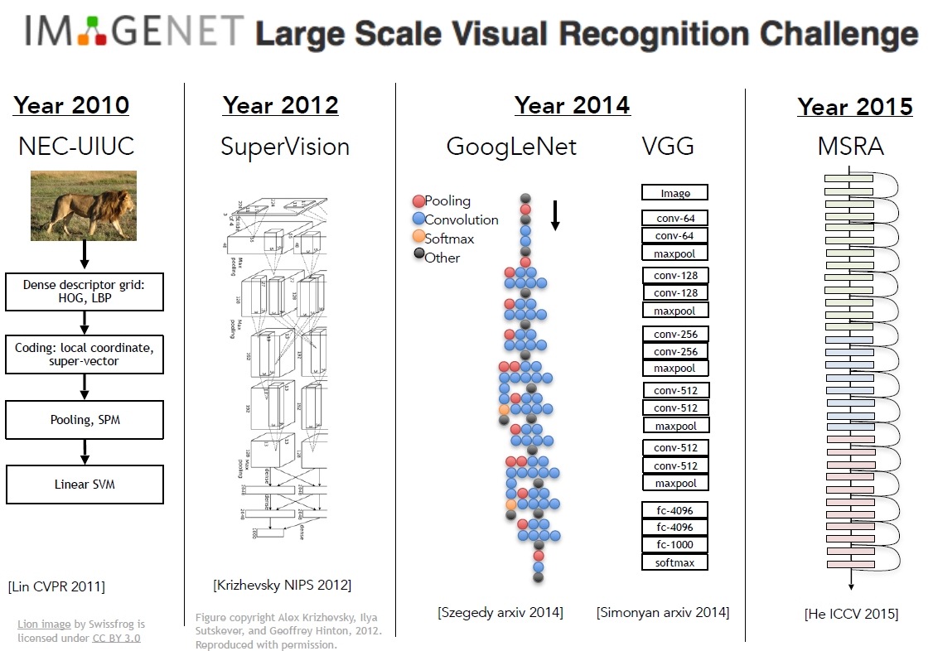

Slide 6
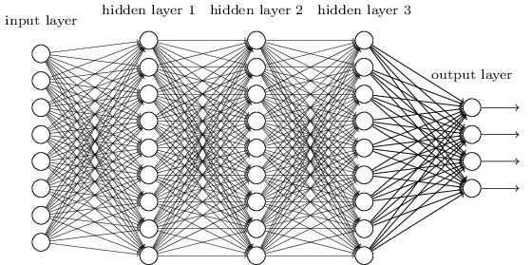
Backpropagation
Feedfoward
Input Signal
Backpropagation was invented in the 1970s as a general optimization method for performing automatic differentiation of complex nested functions. However, it wasn't until 1986, with the publishing of a paper by Rumelhart, Hinton, and Williams, titled "Learning Representations by Back-Propagating Errors," that the importance of the algorithm was appreciated by the machine learning community at large.
Error Signal
Source: https://brilliant.org/wiki/backpropagation/
Backpropagation
Notes:
https://machinelearningmastery.com/binary-classification-tutorial-with-the-keras-deep-learning-library/

Slide 7
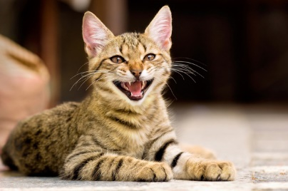
Image Classification with Fully connected Neural Networks
32x32x3 image
3072 vector
Spatial information of the input image is lost in the process

Slide 8
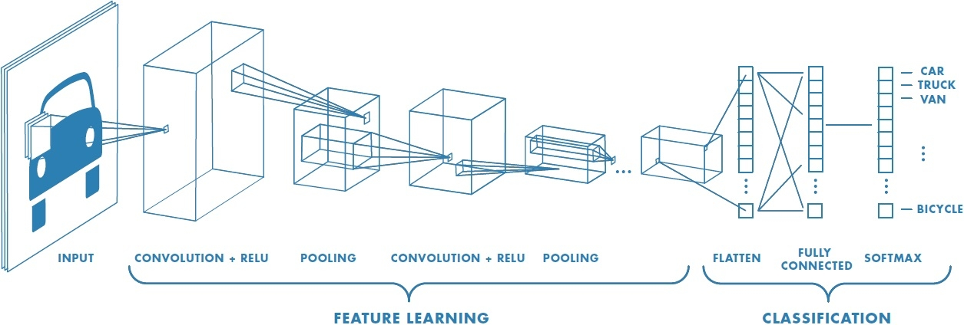
Convolution Neural Network
Source: https://www.mathworks.com/discovery/convolutional-neural-network.html
Spatial information about an image is lost in the process

Slide 9
Convolution Neural Network
7
7
Convolution
3
7
7
3
Filter
Input image/data
7x7 input image/data convolute with 3x3 filter with stride=1

Slide 10
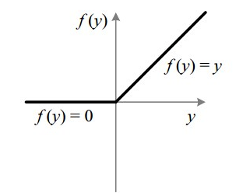
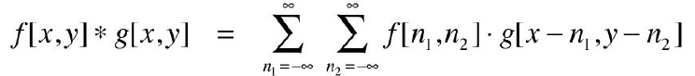
Convolution Neural Network
……..
Relu Activation
Function
Feature/Activation map
Convolution with stride=1

Slide 11
Pooling Layer
112x112x64
224x224x64
Pooling
Pooling
-makes the representation small and manageable
Operate over each feature map independently

Slide 12
Max Pooling
3
4
8
7
5
6
2
9
Max Pooling with stride =2
6
9
8
2
1
3
8
7
1
4
7
2

Slide 13
Generative Adversarial Networks (GANs)

Slide 14
Generative Adversarial Networks (GANs)
GAN is a relatively new Machine Learning architecture for neural networks pioneered by Ian Goodfellow and his colleagues at University of Montreal in 2014
Consist of two competiting Neural Network the Generator and the Discriminator
Source: https://www.kdnuggets.com/2017/01/generative-adversarial-networks-hot-topic-machine-learning.html

Slide 15
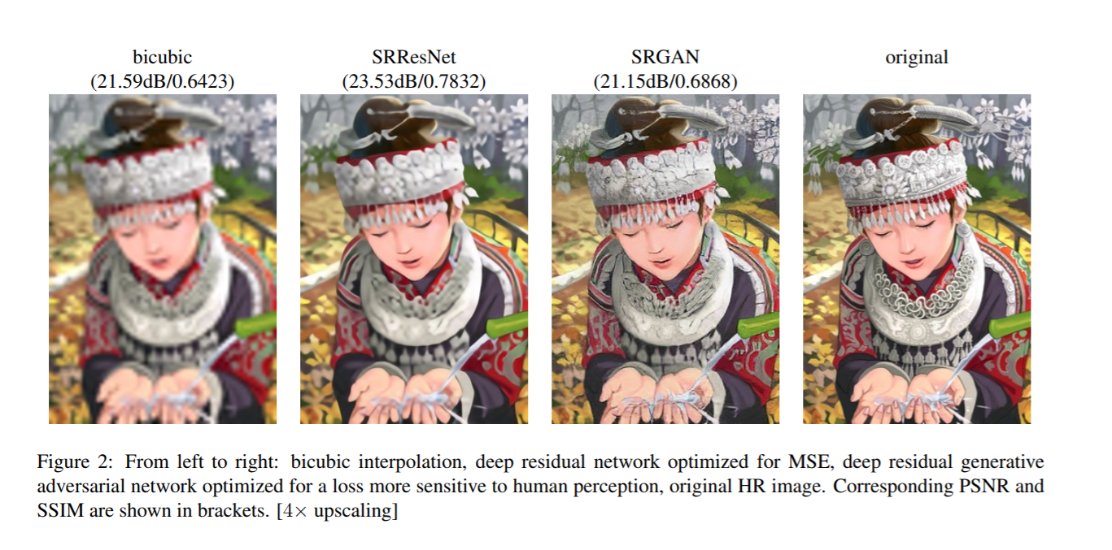
GAN in Texture Generation or Super-Resolution
The Twitter Cortex team uses GANs for super resolution.
Source: https://arxiv.org/pdf/1605.05396.pdf
arXiv paper on “Photo-Realistic Single Image Super-Resolution Using a Generative Adversarial Network”

Slide 16
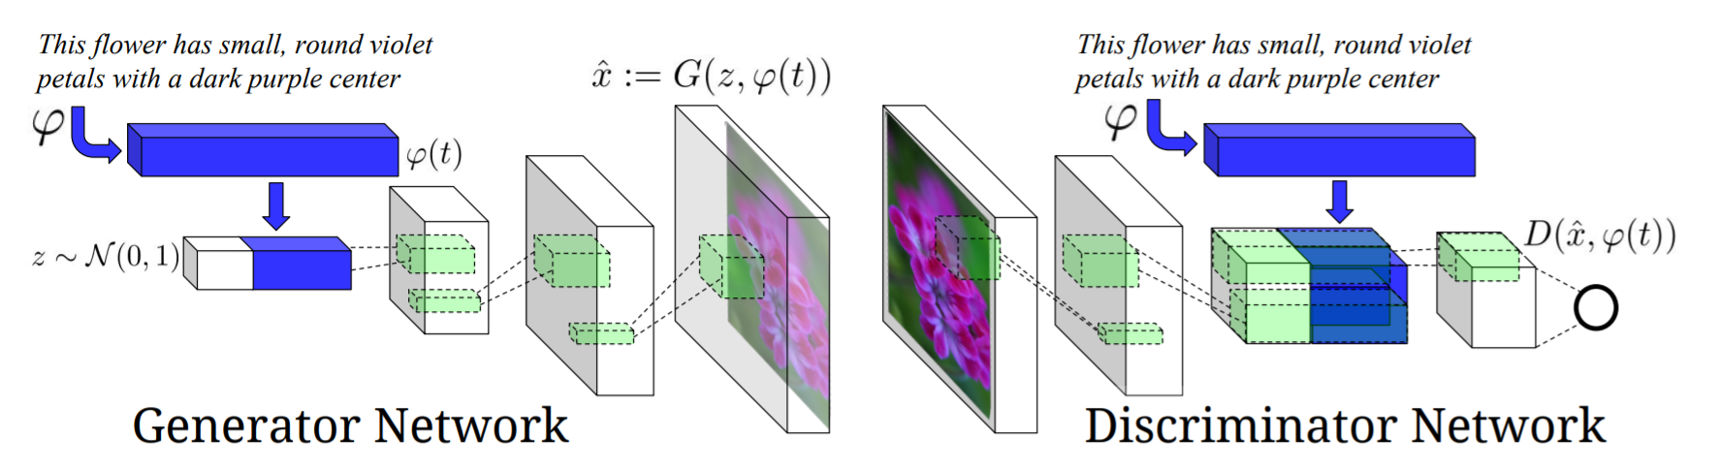
GAN in Text to Image Synthesis
Sourcehttps://arxiv.org/pdf/1605.05396.pdf
Generative Adversarial Text-to-Image Synthesis Scott Reed, Zeynep Akata, Xinchen Yan, Lajanugen Logeswaran, Bernt Schiele, Honglak Lee
Notes:
https://github.com/reedscot/icml2016

Slide 17
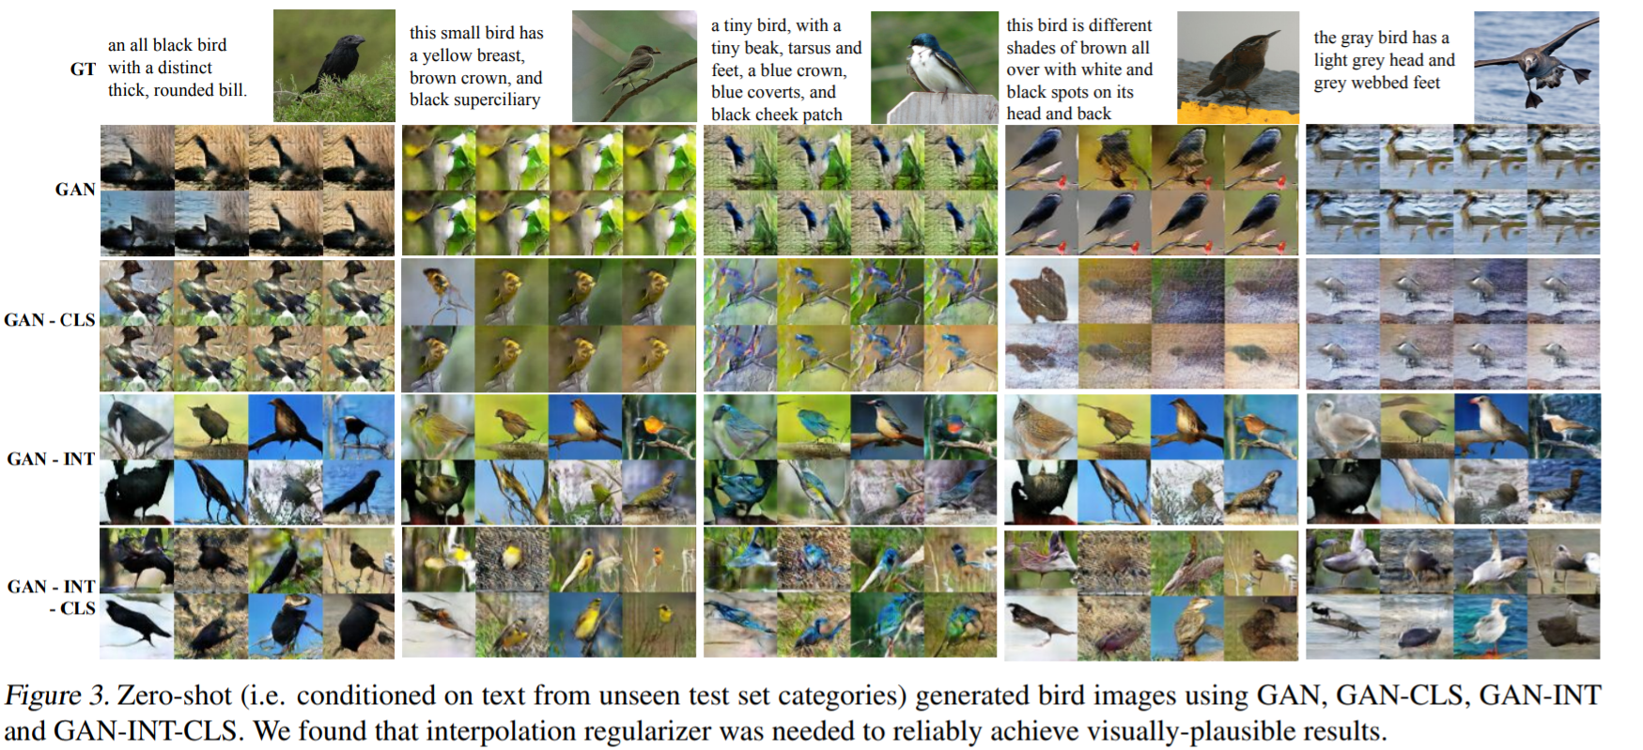
GAN in Text to Image Synthesis
Sourcehttps://arxiv.org/pdf/1605.05396.pdf
Notes:
https://github.com/reedscot/icml2016

Slide 18
Learning Strategy

Slide 19
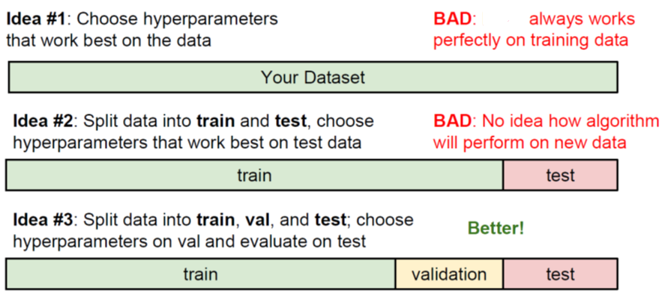
Data Segmentation

Slide 20
Strategy to Improve Prediction/Detection Result
Byes Error
Better
Human Error
proxy of Bayes Error
Train bigger model
Train longer/better optimization algorithm
Model/hyperparameters
search
Human Error
Avoidable bias
Reduction
Train Error
Variance
Reduction
More data
Regularization for NN
Model/hyperparameters
search
Validation
Error

Slide 21
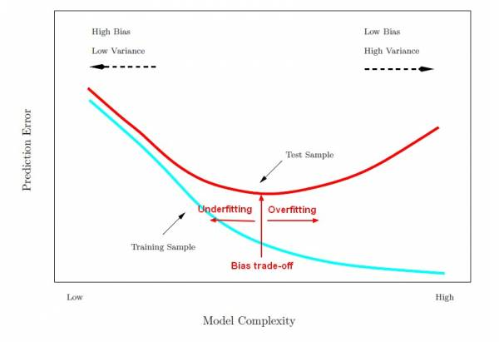
Learning Strategy
Overfitting and regularization

Slide 22
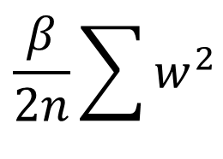
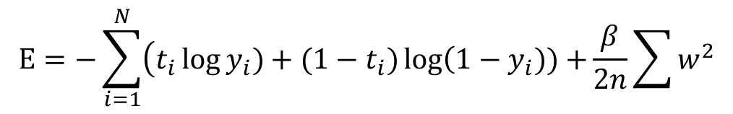
Learning Strategy
L2 Regularization
$$E=−\sum_{i=1}^{N}{\left(t_{i}\log{y_{i}})+(1−t_{i})\log\left(1−y_{i}))+\right.\right.}\frac{β}{2n}\sum{w^{2}}$$
Cross Entropy Cost function
L2 Regularization
Sum of square of weights in the network
Regularization parameter
$$\frac{β}{2n}\sum{w^{2}}$$
Make such that the network prefers to learn small weights
n is the size of training set

Slide 23
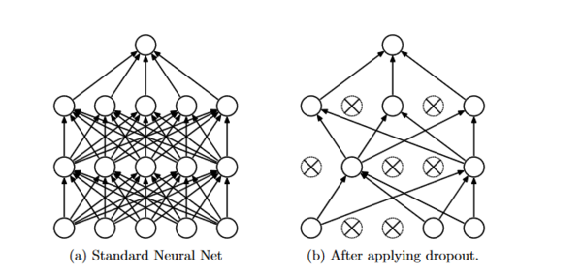
Learning Strategy
Dropout
Dropout essential mean each neuron is drop (does not exist) at random with fixed probability of 1-p and kept with probability p.
The value of p maybe different for different layer in the same network
p=0.5 for hidden layer and p=1 for input layer (no dropout) shown to provide good result
No neuron is drop during evaluation and prediction
The output of each neuron is multiplied by p so that the input to the next layer has the same expected value.
Sources: https://www.commonlounge.com/discussion/694fd08c36994186a48d122e511f29d5

Slide 24
Learning Strategy
Early Stopping

Slide 25

Learning Strategy
Learning Rate
Image Scource: http://cs231n.github.io/neural-networks-3/

